Slide 1

KINGS COUNTY HOUSE SALES PREDICTION
19th April 2023

Slide 2
INTRODUCTION
Real estate developers are interested in identifying factors that influence the sale price of homes in King County, as well as developing models to predict the sale price of homes based on these factors.
This information can be used to optimize the design and marketing of new properties, identify investment opportunities, and make data-driven decisions about the development and sale of properties.

Slide 3
Project overview
The project seeks to optimize the design and marketing of new properties, identify investment opportunities, and make data-driven decisions about the development and sale of properties.

Slide 4
Problem questions
THE REAL ESTATE BUSINESS
To find the relationship between the size and quality of the property and the sale price of homes in King county
To find the relationship between house neighborhood/location and the price.
To establish how accurately we can predict the sale price of homes in King County based on the available features.

Slide 5
DATASETS USED
THE DATA
This project uses the King County House Sales dataset. It includes information about:
The size of the homes which is described by the area in square feet of: The lot, the living area, the basement, the area above ground and the number of bedrooms and bathrooms.
The quality of the homes which is described by the features: condition, grade and the year built.
The neighborhood around which the property stands which is described by: the zicode, the latitude and longitude co-ordinates and the size of 15 properties around it.
Additional features such as: the view and Whether the house is on a waterfront

Slide 6
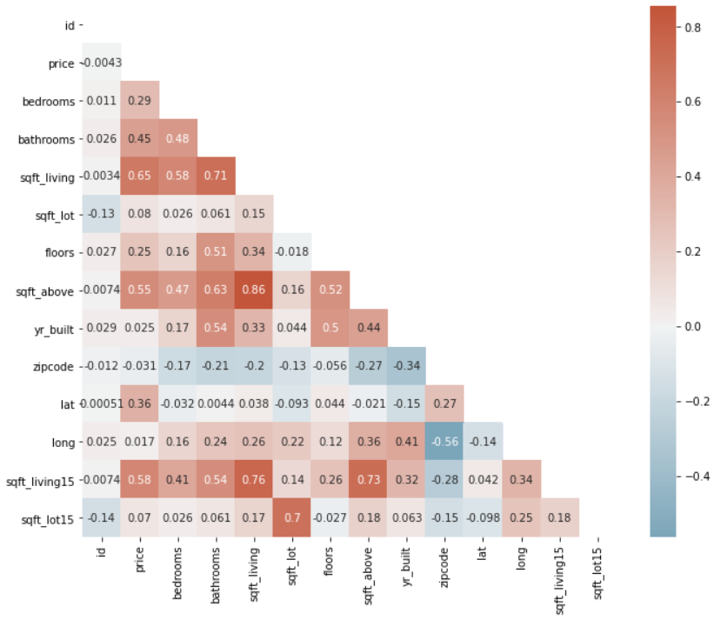
DATA ANALYSIS
A correlation matrix
Analysis of the correlation matrix:
The most strongly correlated feature with the target column price is the square footage of the living space.
This suggests that houses with a larger living area are likely to have higher prices than those with smaller living spaces.

Slide 7
DATA ANALYSIS
Analysis of the size/quality of the home and the sale price
Analysis:

Slide 8
DATA ANALYSIS
Analysis of theneighborhood/location and the price
Analysis of the chart:

Slide 9



Project analysis slide 3
RECOMMENDATIONS
MAIN OBJECTIVE
The main objective of the project is:
Size and Quality
Location
Confidence
Explained here
Explained here
Explained here

Slide 10
Thank You. Any questions?
JIMCOLLINS WAMAE
LEO KARIUKI
MAUREEN KITANGA
PRISCILA KAMIRI
SAMUEL KYALO
STEVE GITHINJI

